Slide 1

SE Main/20th/21st St railroad grade separation project Construction
Community Information Meeting
July 11, 2018
City of Moorhead Engineering Department
Ames Construction
SRF Consulting / Braun Intertec

Slide 2

Goals
Project History 2002-Present
What will remain the same
Planned Detour information
Traffic Calming Measures
Keep connected
Adaptability
Flexibility

Slide 3

Project History
2000: Study of 34th Street/I-94 Interchange and Railroad Relocation Alternatives
2002: Preliminary engineering & environmental assessment (EA) begins
2006: Right-of-way acquisition & final design begins
2007: Final EA & Finding of No Significant Impact
2009: 95% Plans Complete
2011: Building demo & site preparation
2017: $42.262M State grant awarded
2018: Additional $6M State grant awarded; bid awarded to Ames Construction Inc.; construction begins

Slide 4
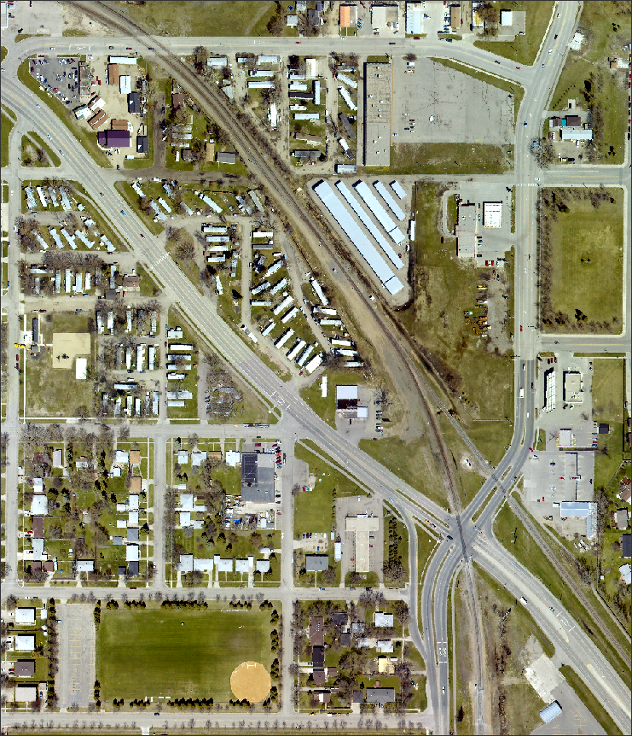
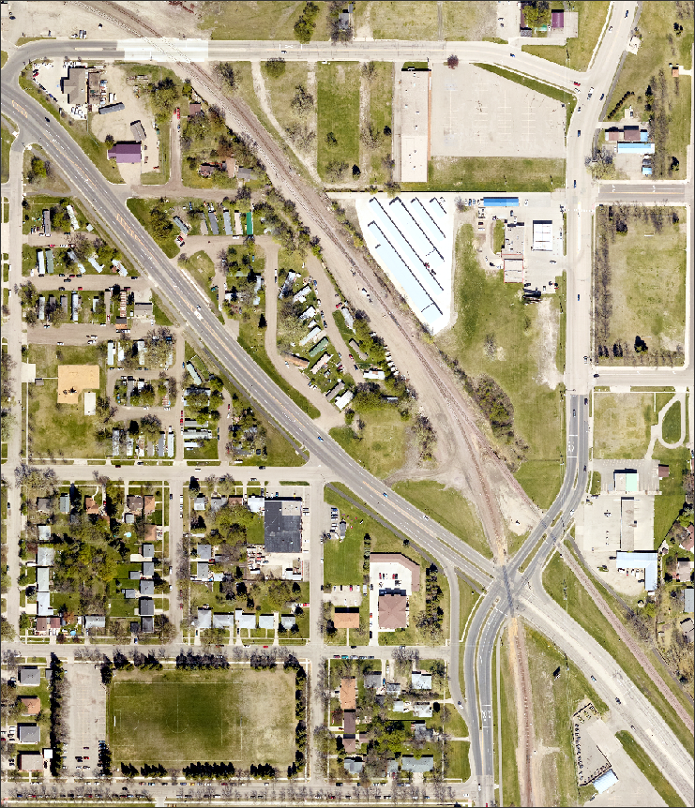
Project History
2002
2017

Slide 5
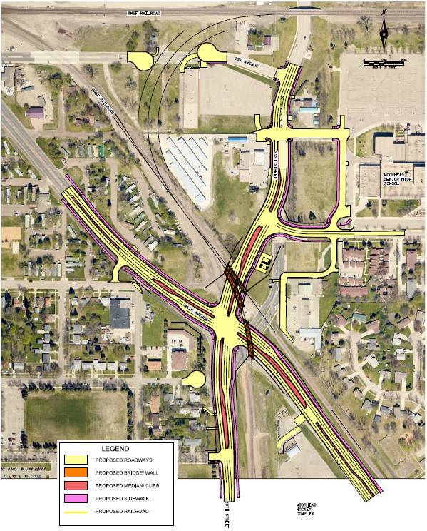
What to Expect
Construction Noise & Traffic
Temporary Signals
Business Access / Destination Signage
School Access
Changes happening as construction evolves
Any specific questions can be taken individually after the presentation

Slide 6
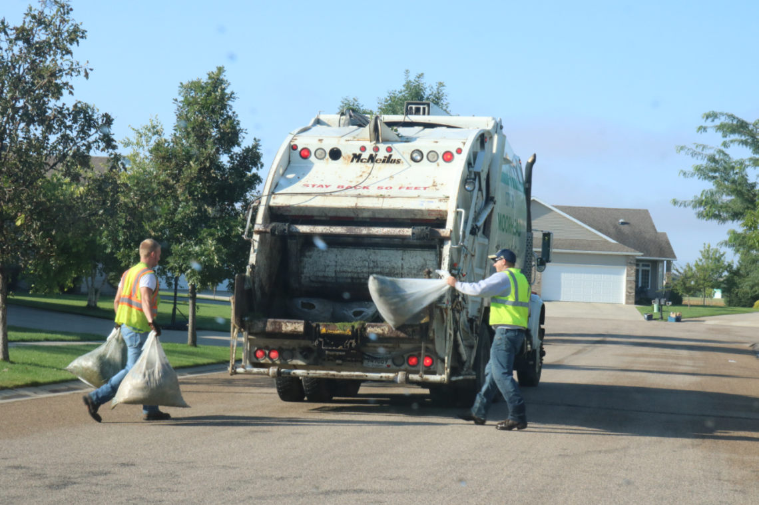
What will not be affected by construction
With limited exceptions
Physical access to home driveways
Garbage Pick Up
Mail Delivery
Snow Removal
Services on regular schedule

Slide 7
Construction Schedule
Typically Monday through Friday 7am-7pm
Saturday work only as needed
Construction traffic should be restricted to major roadways & actual construction limits
Contractor will use existing City properties for staging of equipment and materials
Any concerns, please reach out to Tom Trowbridge at 218.299.5395

Slide 8
Construction Schedule
Ongoing relocation of private / public utilities (Xcel Energy and MPS Electric)
4th Ave S / Euclid St / 2nd Ave S (Ames)
Stormwater Pumping Station, Walls (Ames)
Railroad Shoofly (BNSF)
Bridges, East & North Approaches, Walls (Ames)
Permanent Railroad Tracks (BNSF)
West & South Approaches, Walls (Ames)
1st Ave S Closure / Cul-de-Sacs (Ames)
Railroad Wye (BNSF)

Slide 9
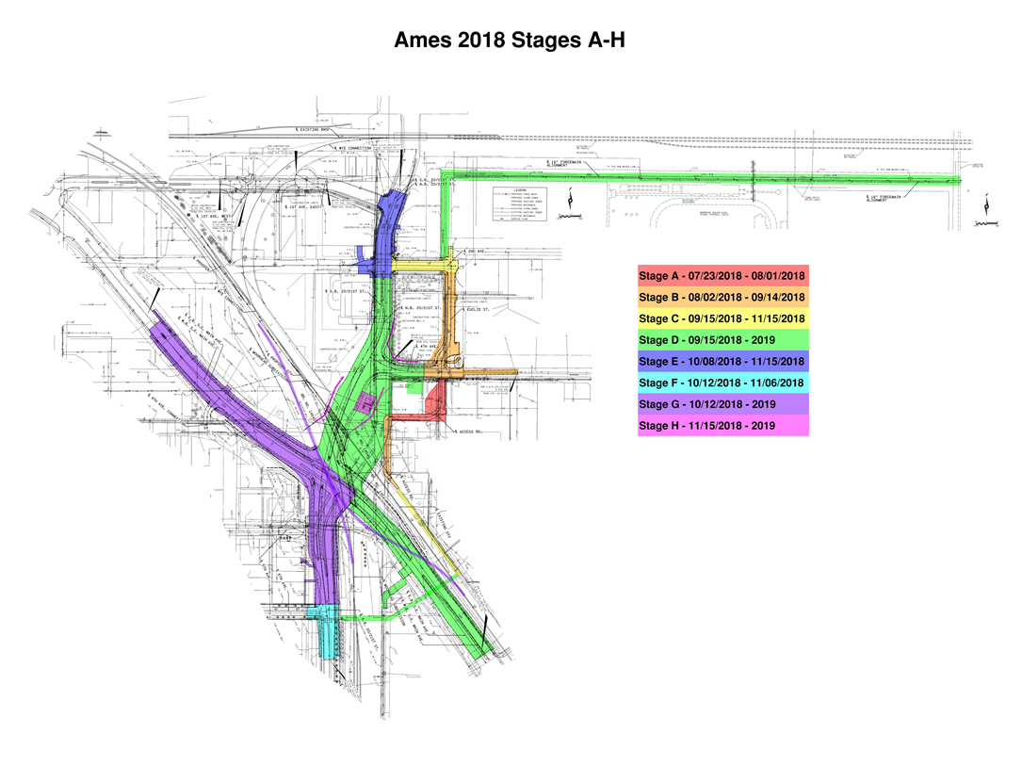

Slide 10
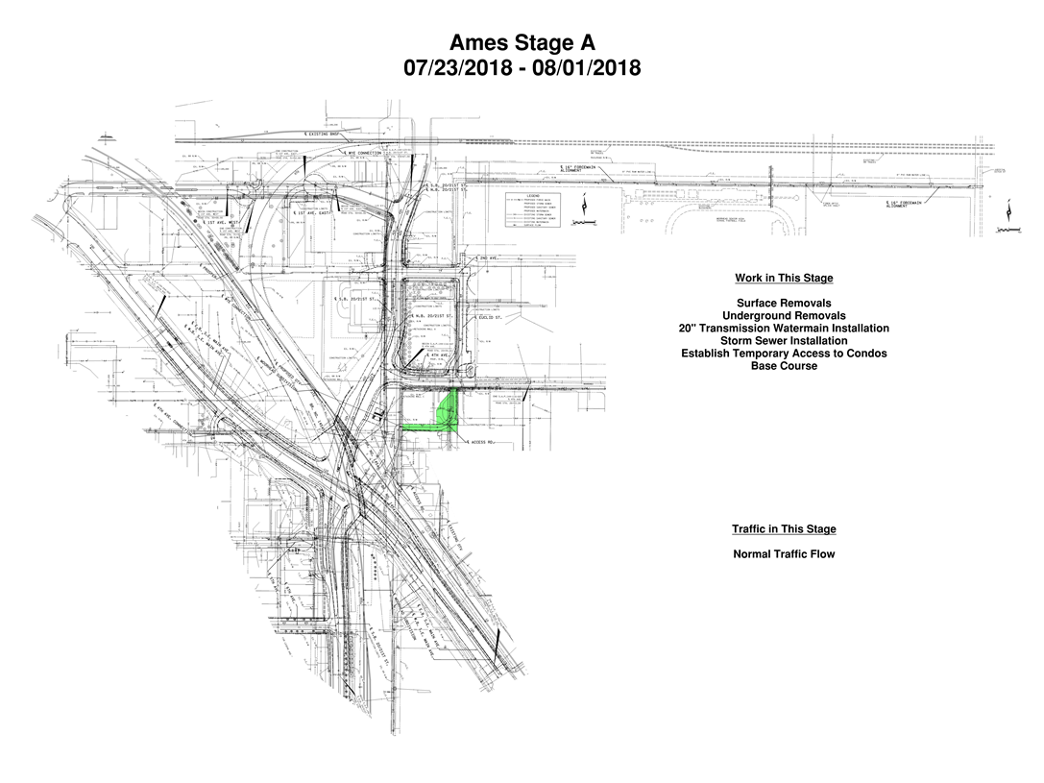

Slide 11
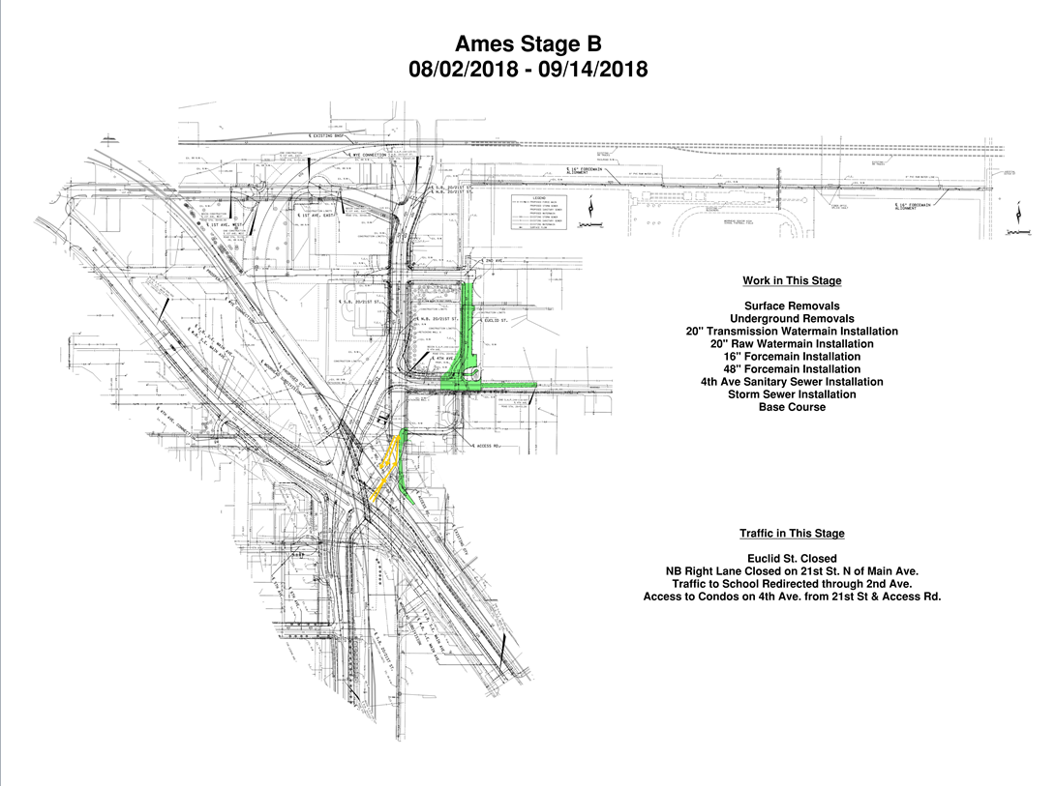

Slide 12
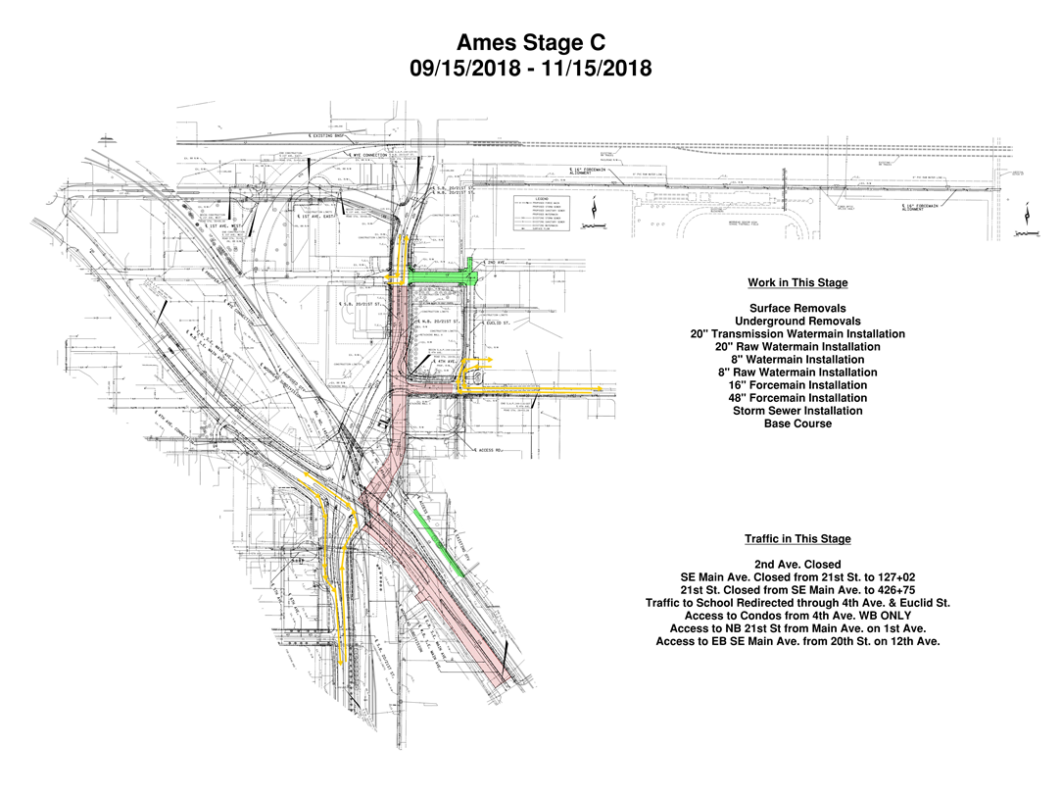

Slide 13
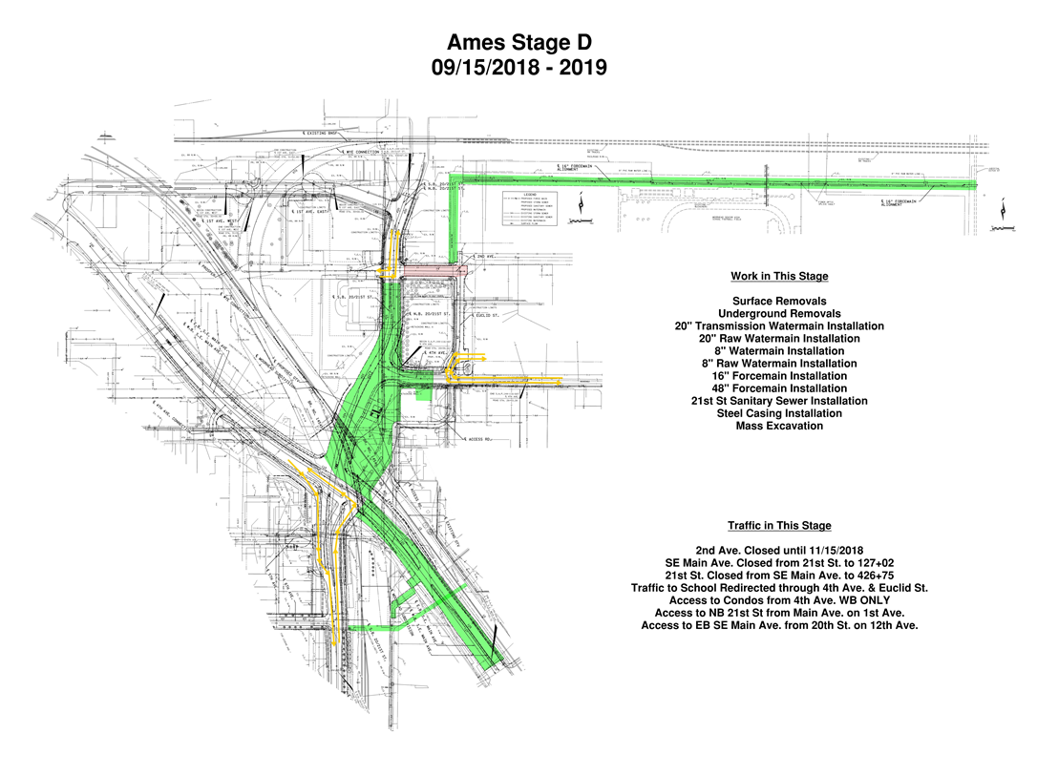

Slide 14
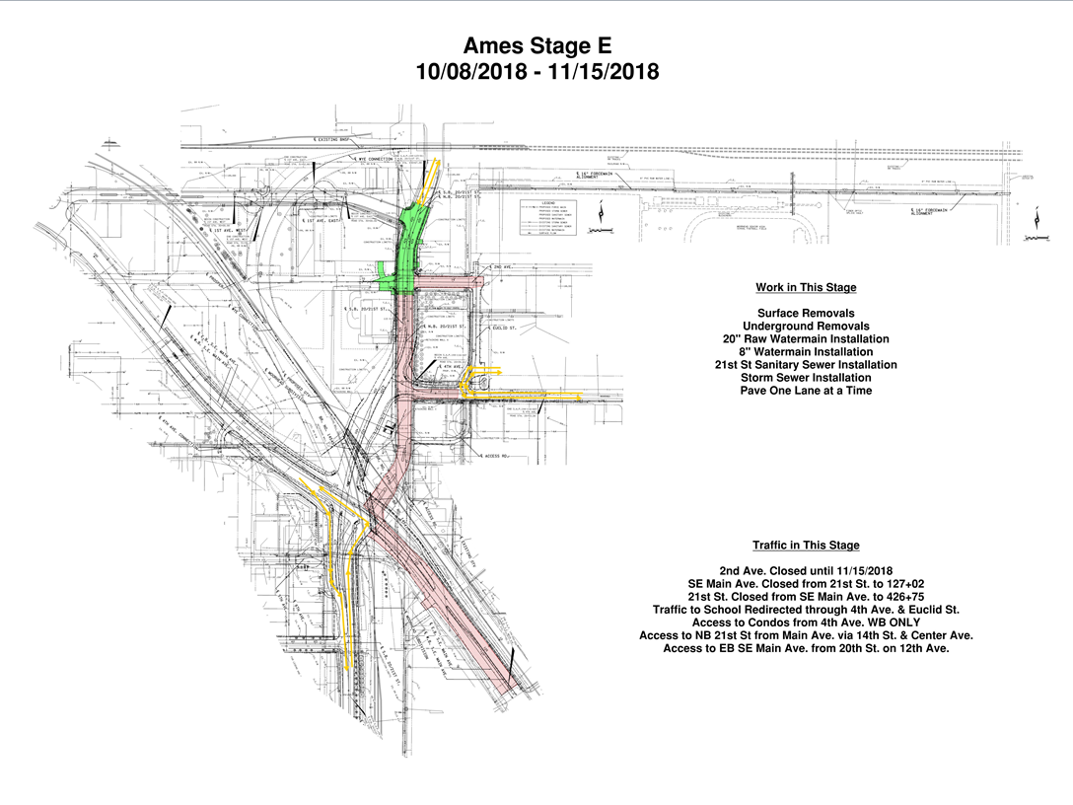

Slide 15
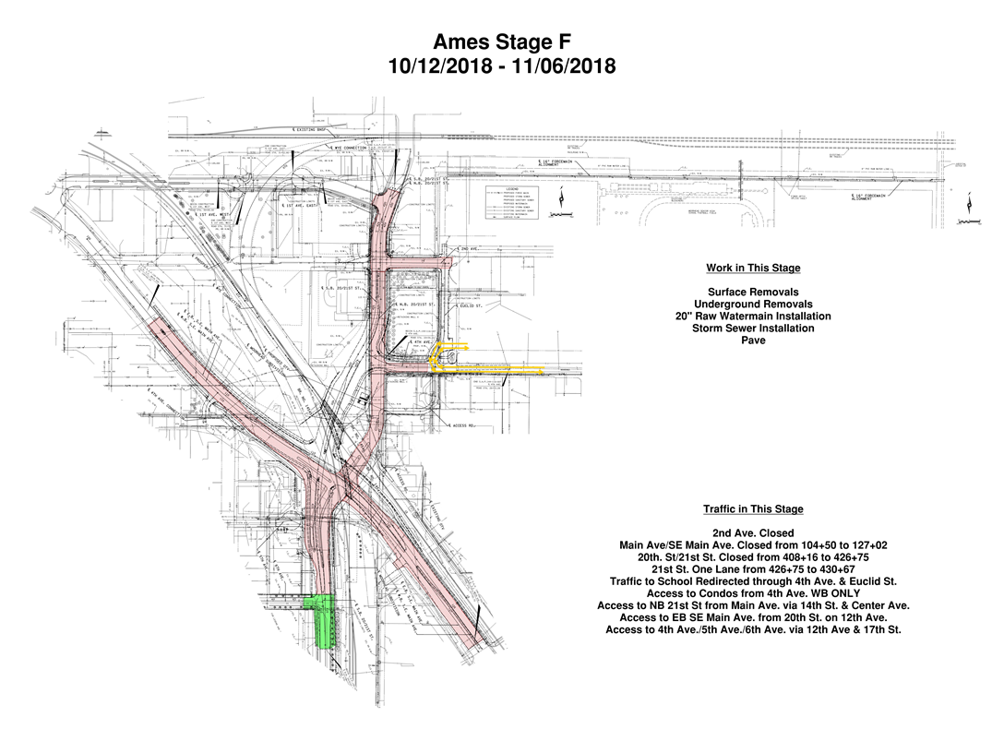

Slide 16
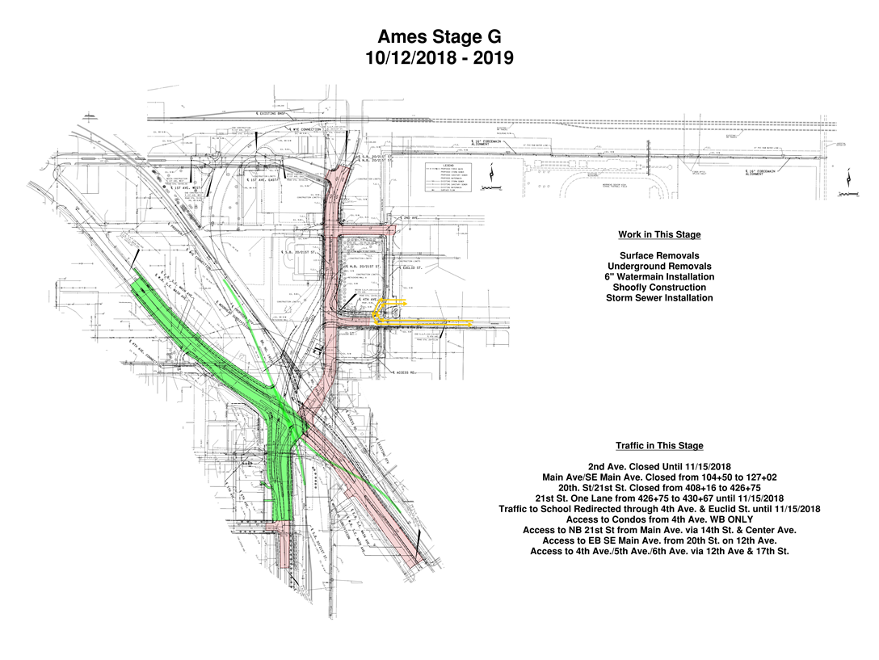

Slide 17
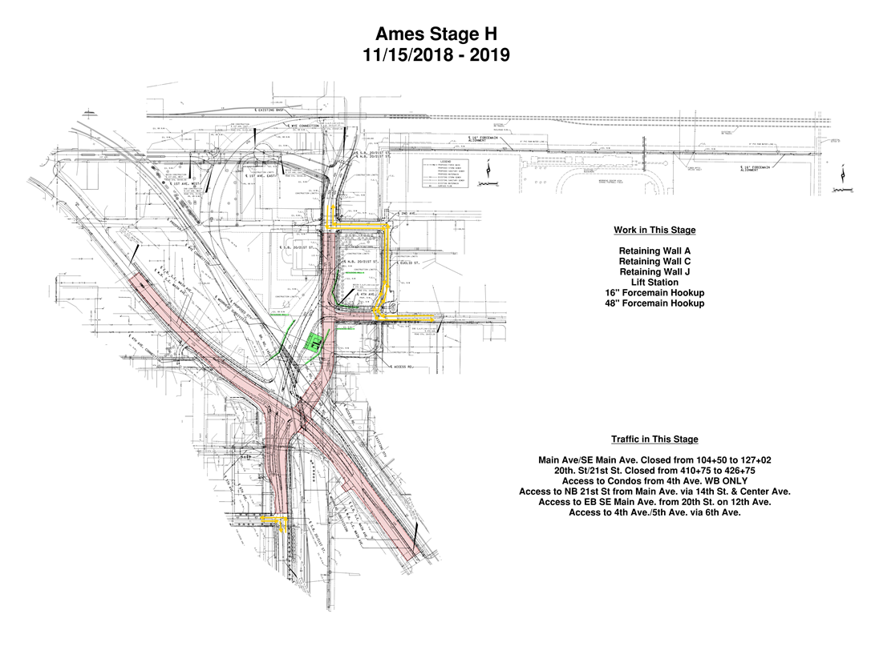

Slide 18

Proposed Major Detours
What is closing?
When?
For how long?
Dates to be determined
Area Businesses
  Destination Signage
  Business Signage

Slide 23
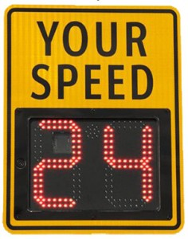
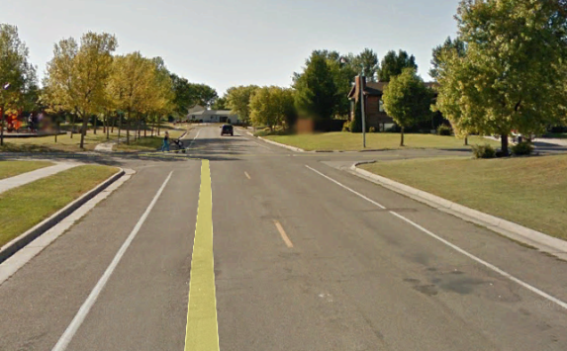

Planned Traffic Calming Measures
Speed Feedback Signs
Pavement Marking
  Parking and Lane Delineation
Extra enforcement
Roundabout…

Slide 24
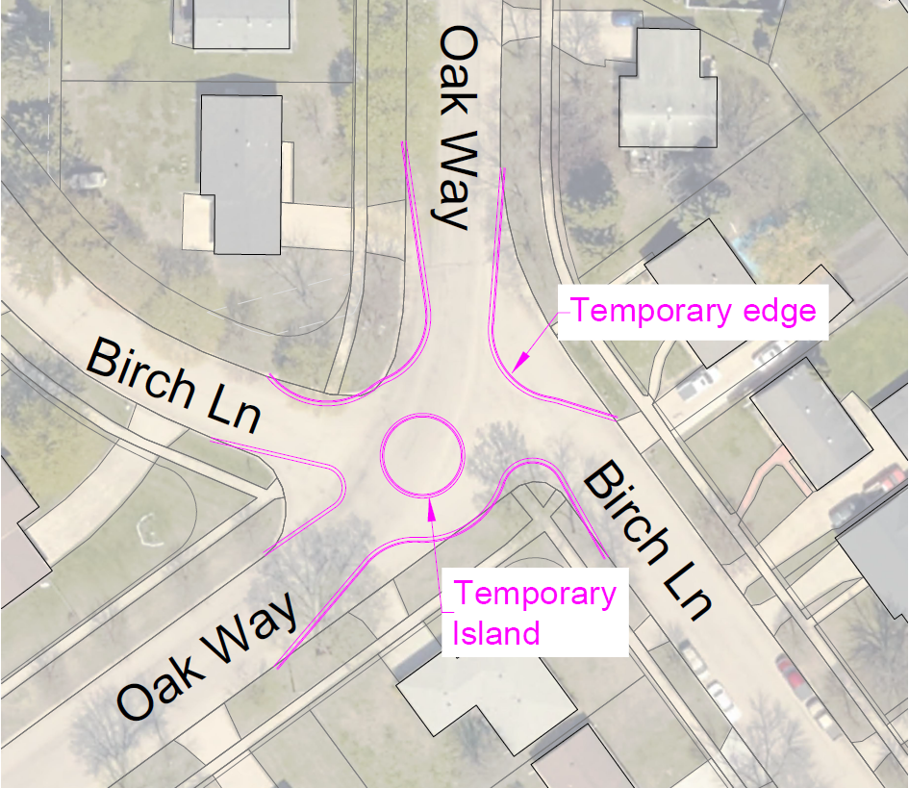
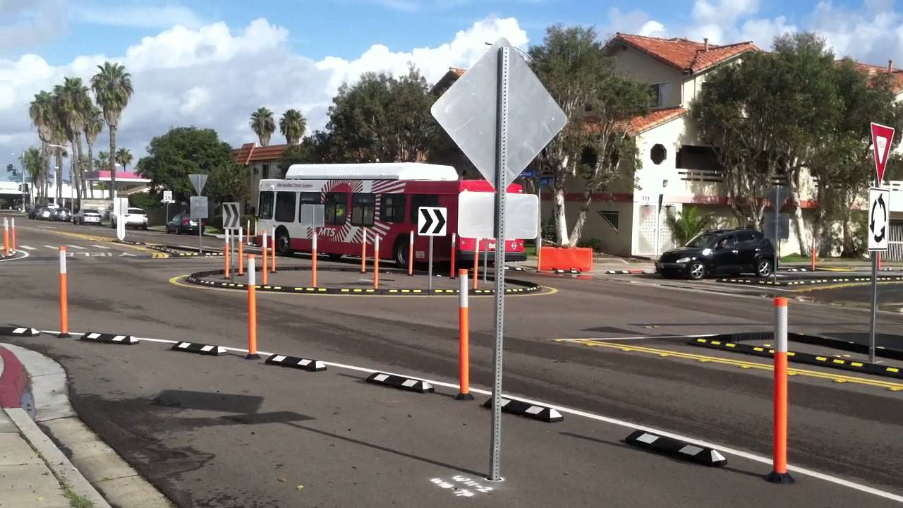

What do you think?

Slide 25
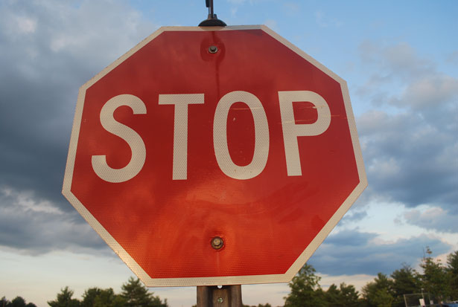
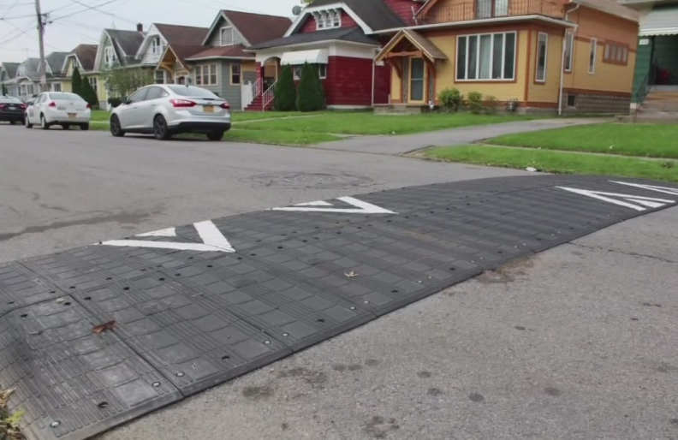
Adaptive Traffic Calming Measures
Temporary Stop Signs
Targeted Enforcement
Temporary Speed Humps
Other Measures?

Slide 26
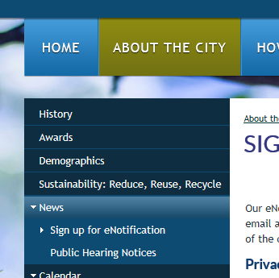
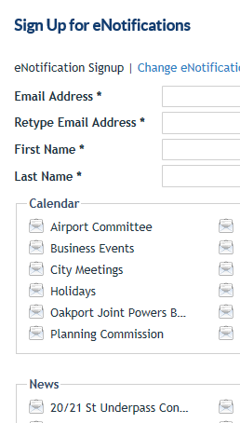
Keep up with the latest Information
Join the e-Notifications group to get the most up to date information on the project
  Information will be sent directly to your email

Slide 27

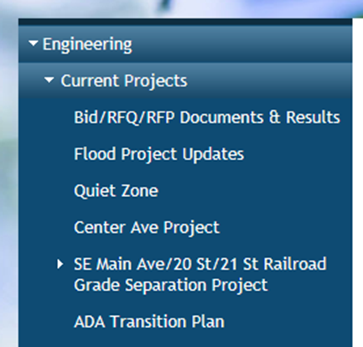
Keep up with the latest Information
Check out the SE Main page on the City of Moorhead Website for additional information
  Weekly Updates

Slide 28



Construction Partners
Ames Construction: Contractor
SRF Consulting: Construction Administration
Braun Intertec: Construction Materials Testing, Hazardous Materials Management, Environmental Testing, and Vibration Monitoring
City Contacts
Tom Trowbridge, Assistant City Engineer
  General Construction Questions 218.299.5395
Jon Atkins, City Traffic Engineer
  Detour and Traffic Concerns 218.299.5388
Levi Hockett, City Inspector
  Specific Construction Questions 218.299.5396
For Other Inquiries
  engineering@ci.moorhead.mn.us

Slide 29
Thank you!
We appreciate your support to make our City a safer place
We ask for your flexibility with ongoing changes throughout the construction process
  If you have any questions or concerns please contact the Engineering Department at
      218.299.5390
      engineering@ci.moorhead.mn.us

